Slide 1
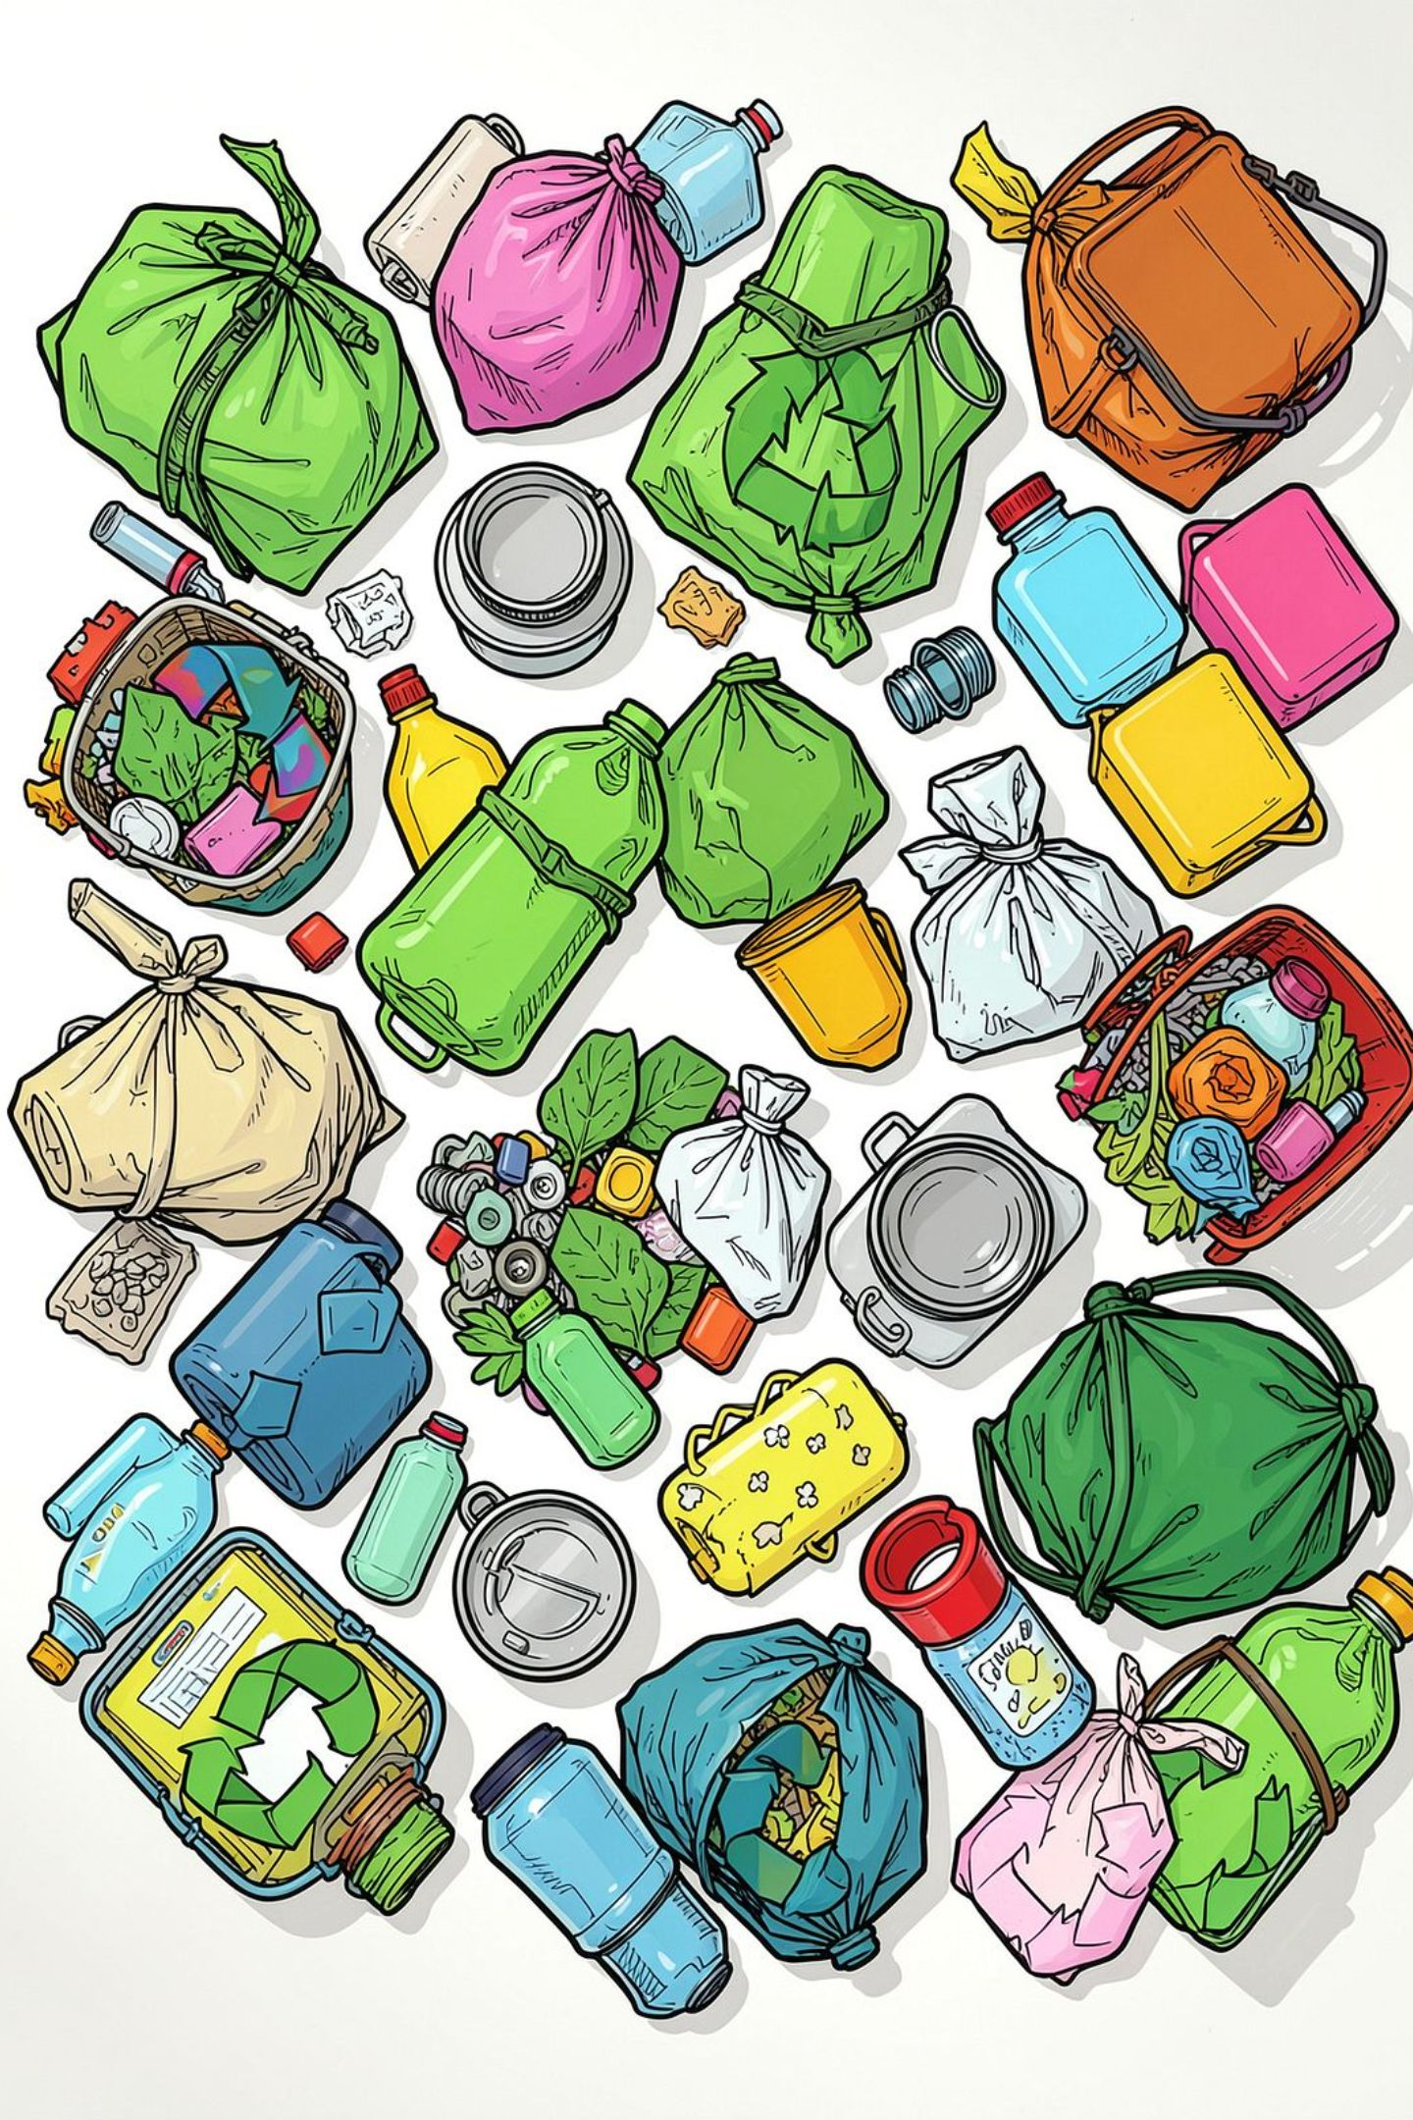
AI-Powered Smart Waste Segregation
From student project to real-world impact — aligning our team on next steps and ownership.
1M1B INTERNSHIP
NAME :SAUMYA SINGH
COLLEGE ACCURATE INSTITUTE OF MANAGEMENT AND TECHNOLOGY

Slide 2
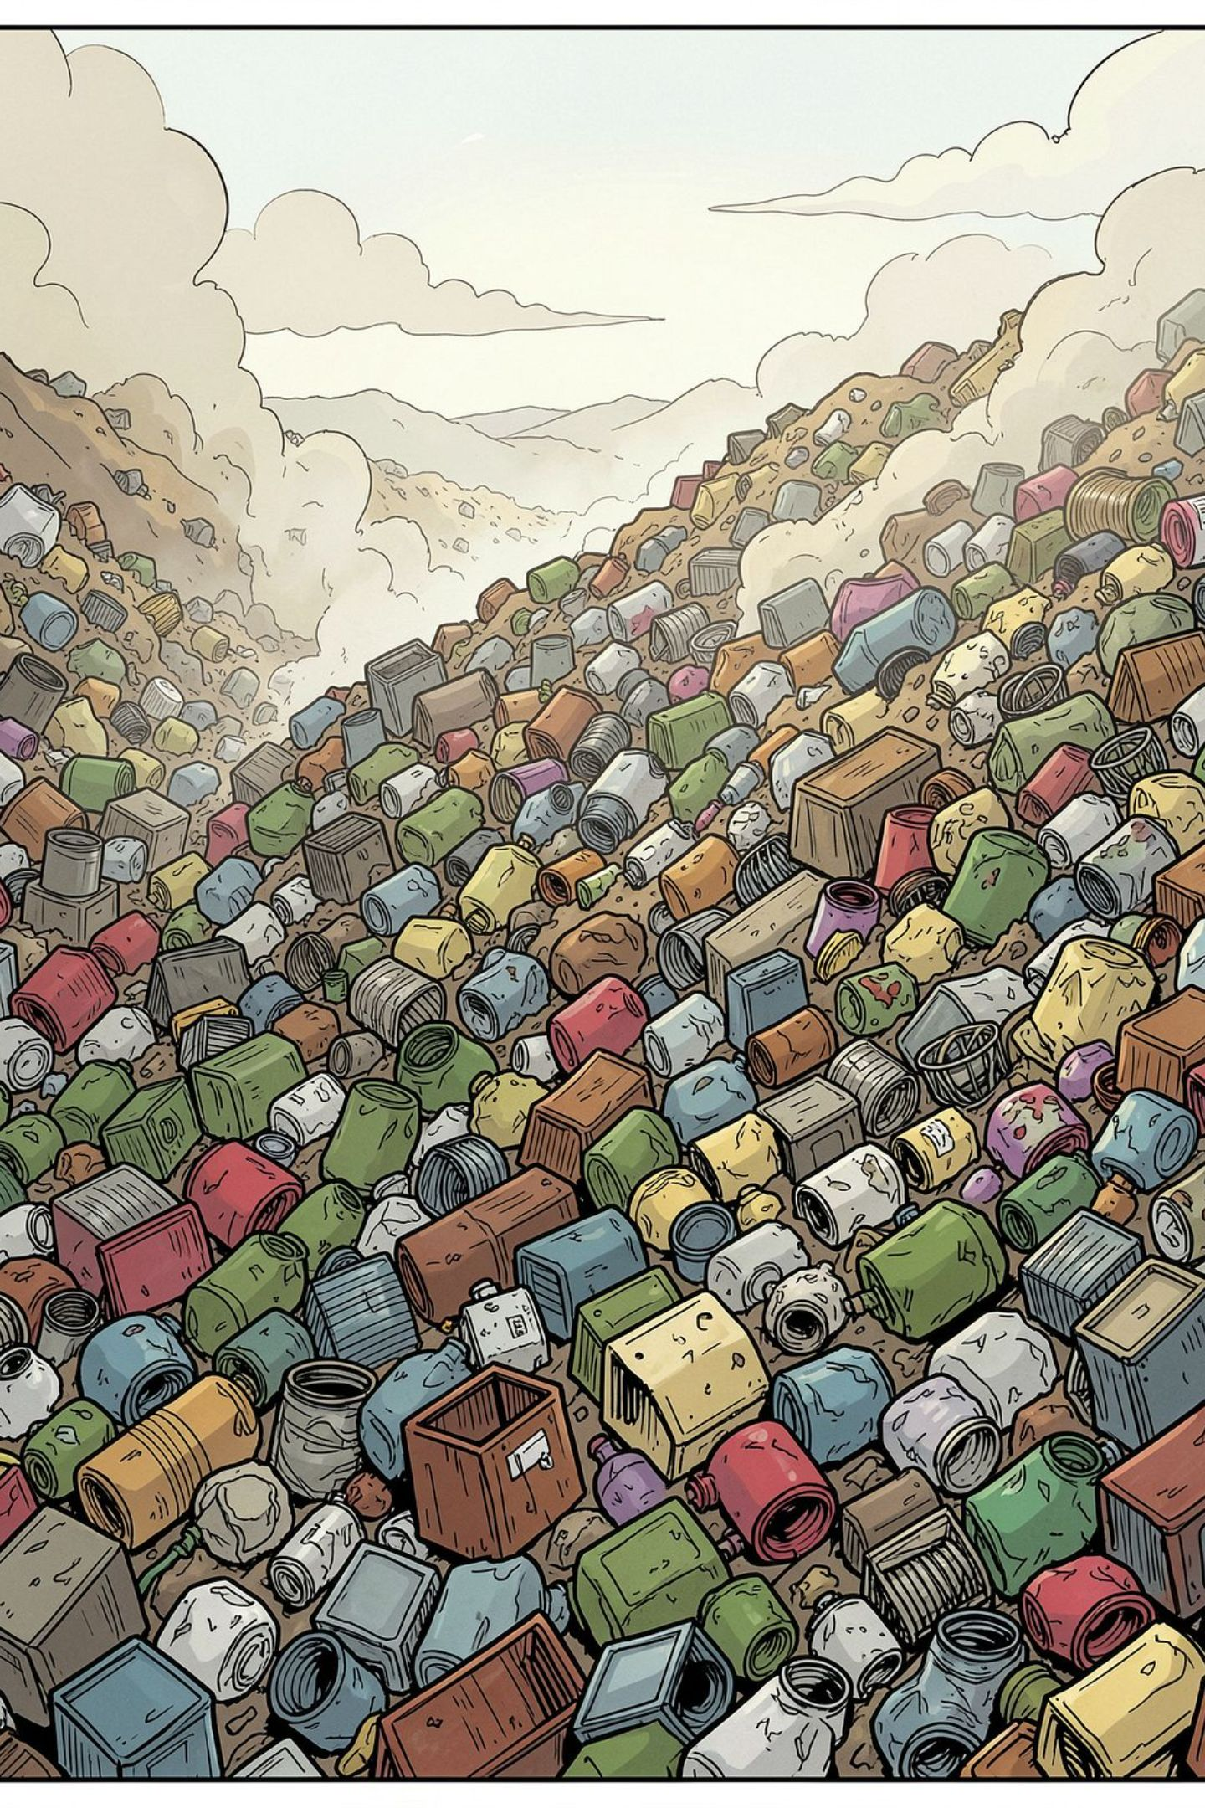
The Problem
Contamination Crisis
No Guidance at the Point of Disposal
Improper waste segregation contaminates recyclables at the source — turning recoverable materials into landfill burden.
Users lack simple, accessible tools to know what goes where. The result: confusion, avoidance, and preventable waste.

Slide 3



Our Solution
Image & Text Classification
Clear Disposal Guidance
Awareness & Habit Change
AI-powered assistant classifies waste from a photo or a simple item description — no expertise required.
Instant, actionable advice on how to dispose of or recycle each item responsibly.
Builds long-term responsible waste management habits across students and communities.

Slide 4
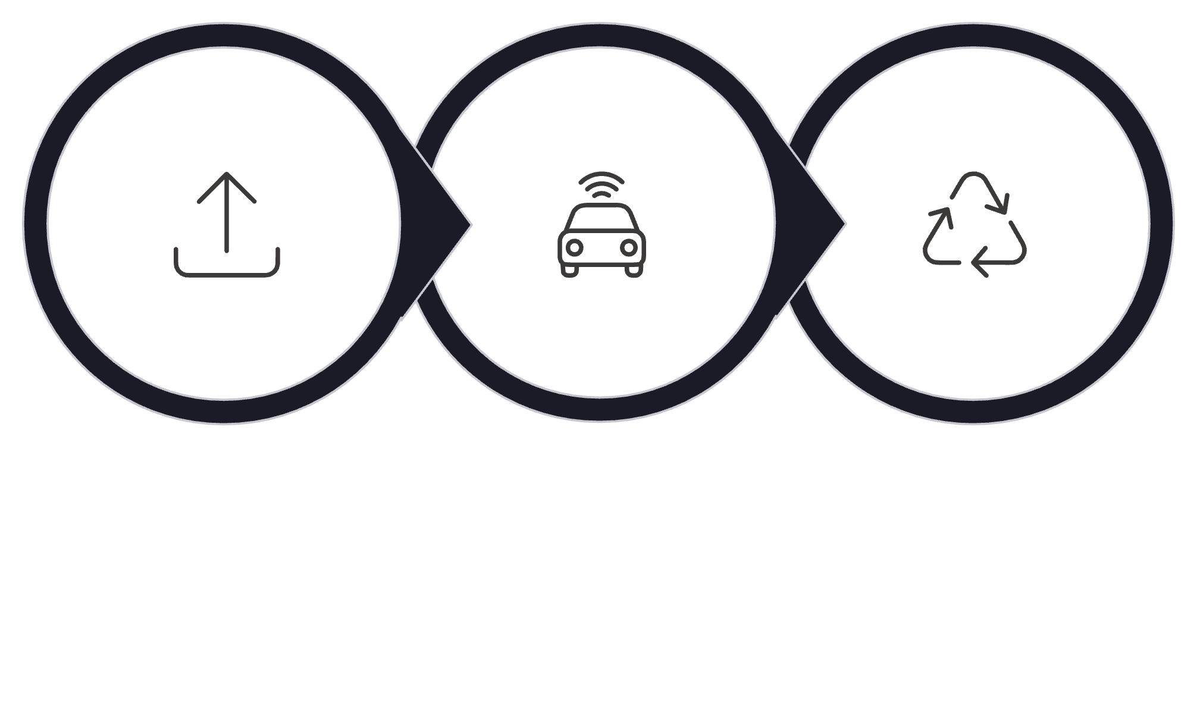
How It Works
AI Classification
Disposal Advice
Upload Item
A simple, three-step flow that any user can complete in seconds — no technical knowledge required.

Slide 5
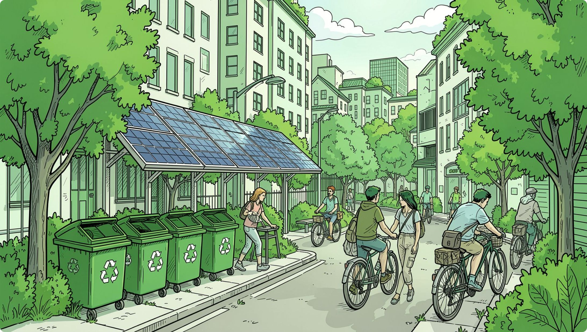


Impact & Alignment
🌍 Environmental
Better segregation drives more recycling and dramatically reduces contamination.
🤝 Social
Improves awareness and supports responsible disposal habits at community scale.
🎯 SDG Alignment
Directly supports SDG 12 (Responsible Consumption) and contributes to SDG 11 & 13.

Slide 6

Next Steps & Owners
Each workstream needs a named owner. Use this card to assign accountability before the next sync.
Workstream | Key Action | Owner
Prototype Refinement | Test accuracy across diverse waste types | [ Owner needed ]
Privacy & Safety Review | Implement responsible AI safeguards | [ Owner needed ]
User Testing | Validate with students and communities | [ Owner needed ]
Deployment Planning | Define rollout strategy and milestones | [ Owner needed ]
Assign owners in your next team meeting. Unowned workstreams stall progress.

Slide 7
Key Responsible AI Principles
⚖️ Fairness
🔍 Transparency
Test the model across diverse waste types and geographies to prevent classification bias.
Explain AI classifications clearly so users understand and trust the guidance they receive.
🔒 Privacy
🛡️ Safety
Minimize personal data collection — images should be processed without unnecessary retention.
Flag low-confidence items for manual verification to prevent harmful disposal advice.

